Slide 1
NYC Short-Term Rental Analysis
Suna Jayyousi
Pillow Palooza

Slide 2
Introduction
Pillow Palooza is a start-up focused on disrupting the traditional real estate market by offering short-term rental options for travelers. The company has seen a significant increase in demand for short-term rentals in New York City, but wants to better understand the market in order to optimize their business strategy.

Slide 3
Introduction
Data were collected from various sources on Airbnb listings in New York City to gain insight into the market. We decided to analyze this data ,in order to provide recommendations on how to maximize revenue and occupancy rates for short-term rental properties.

Slide 4
most popular neighborhoods for short-term rentals in New York City
Through this link:
https://public.tableau.com/app/profile/suna.jayyousi/viz/suna121234/Dashboard1?publish=yes
Mott heaven in Bronx 46 listings, Bedford in Brooklyn with 2206 listings ,Harlem in Manhattan 1435 listings ,Astoria in queens with 448 listings, Tompkinsville in staten island 33 listings.

Slide 5
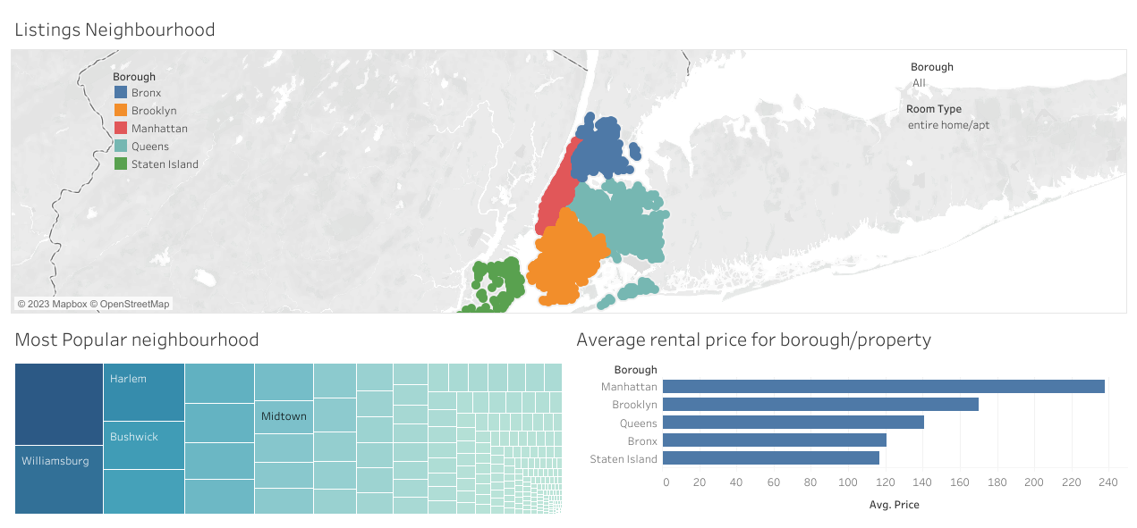
average rental price for short-term rentals in New York City based on borough and property type
Room type: entire home/apt

Slide 6
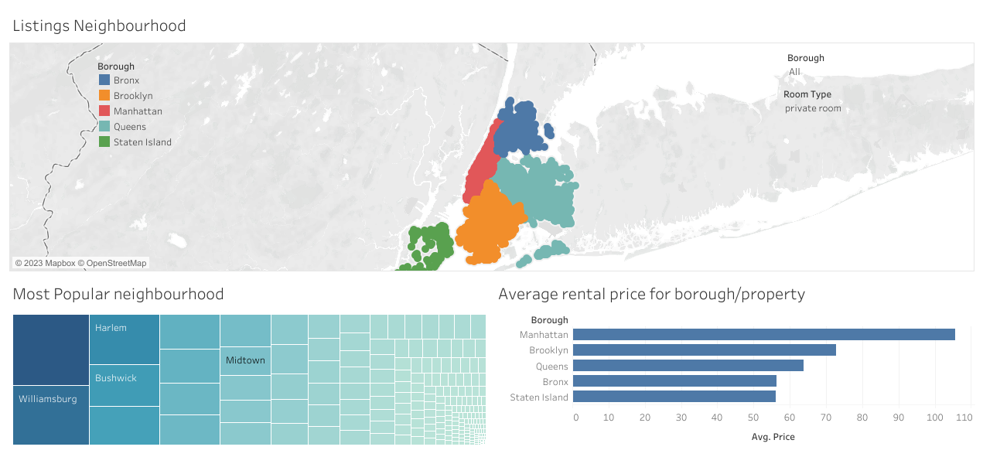
average rental price for short-term rentals in New York City based on borough and property type
Room type: private room

Slide 7
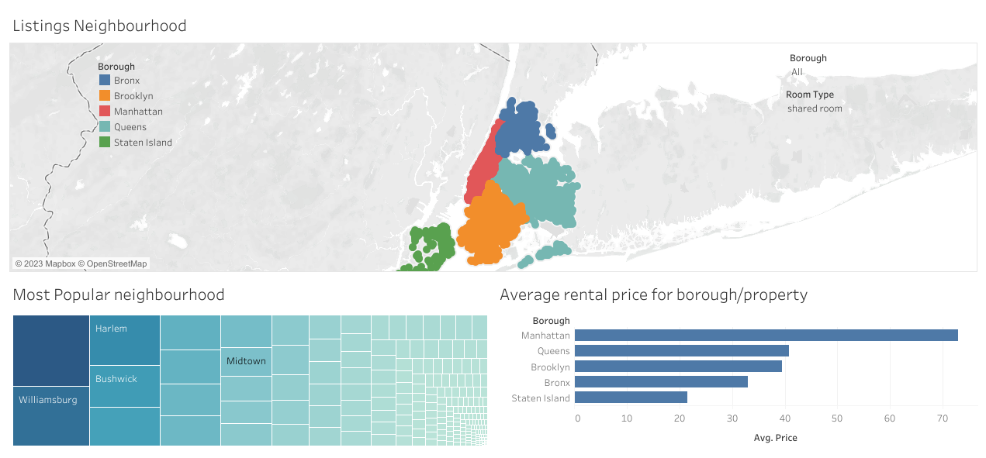
average rental price for short-term rentals in New York City based on borough and property type
Room type: shared room

Slide 8
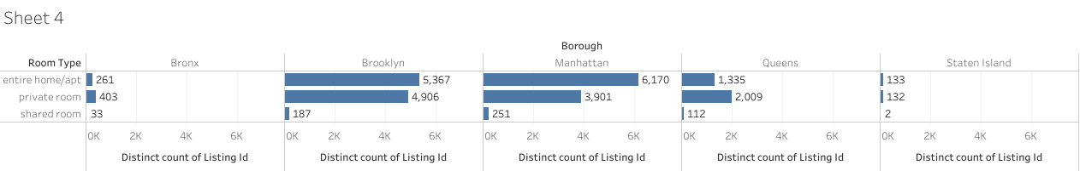
most commonly rented property types on Airbnb in New York City

Slide 9
Recommendation
- most popular property type is home entire then private room , so we recommend company to focus on this two type to increase revenue.
- Manhattan and Brooklyn are the most popular borough short rental property , we recommend to focus on this places to increase revenue.
-queens has a less avg rental price for all property type , so we can make offer for customers to rent there and also we can gain more revenue .

